Slide 1

Effective Communication Skills for Difficult Situations
STEFANIE ROBACK LCSW, LCAS
ARISE COUNSELING AND THERAPY

Slide 2

Stefanie Roback LCSW, LCAS
Master of Science in Social Work from Columbia University NYC 2016
Licensed Clinical Social Worker
Licensed Clinical Addiction Specialist
FOUNDER & CLINICIAN
Arise Counseling and Therapy Wrightsville Beach, NC

Slide 3

Disclaimer
This presentation is for the purpose of broad overview of a skill to address unhelpful thought patterns. This is not a replacement for therapy, medication or mental health treatment of any kind. If you need help finding resources, please reach out to me following this presentation.

Slide 4
why talk about this
Challenges are inevitable and should not be avoided
Equip yourself to feel more prepared and therefore less likely to avoid, shut down or become defensive

Slide 5
build authentic relationships
Connect with other employees - ask how they’re doing (life not just work)
Ask meaningful questions (remember + follow up)
Be vulnerable
Model healthy behaviors
Recognize and appreciate the accomplishments and strengths of your team members
builds a foundation

Slide 6
building self-awareness around communication
Pay attention to your conversations over the next week
Notice patterns
Notice things you wish you would/wouldn’t have said
Notice how others received your communication style
Identify your own communication style and pitfalls

Slide 7
types of communication
Passive
poor eye contact
lack of confidence
does not express own needs/wants
prioritizes needs of others
soft spoken
allows others to take advantage

Slide 8
types of communication
Aggressive
Speaks loudly
Not willing to compromise
Interrupts/does not listen
values only their own needs
disrespectful
criticizing

Slide 9
types of communication
passive-aggressive
Neither of our wants matter
Does not communicate needs/wants clearly
Holds on to negative emotions
Expects mind reading
Rude

Slide 10
types of communication
Assertive
Values both parties wants/needs
Listens
Does not interrupt
Willing to compromise
Stands up for own rights
Confident
Good eye contact

Slide 11
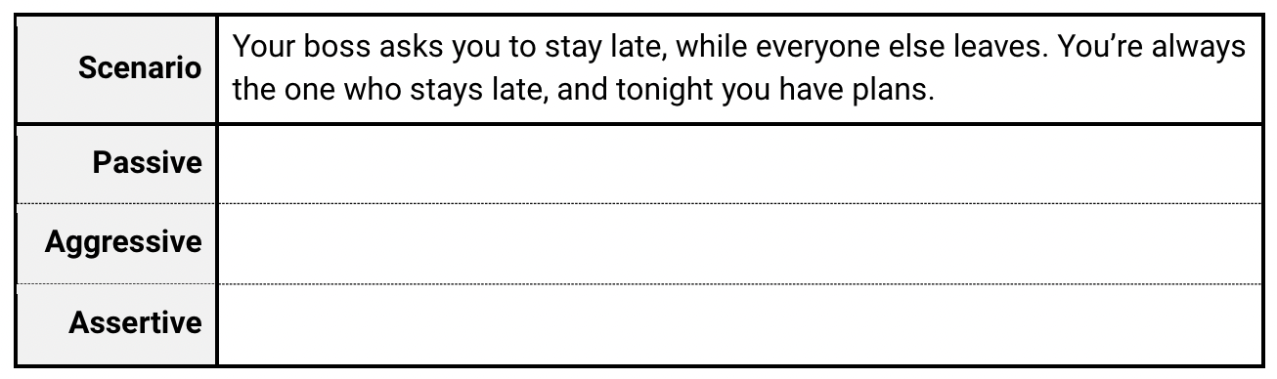
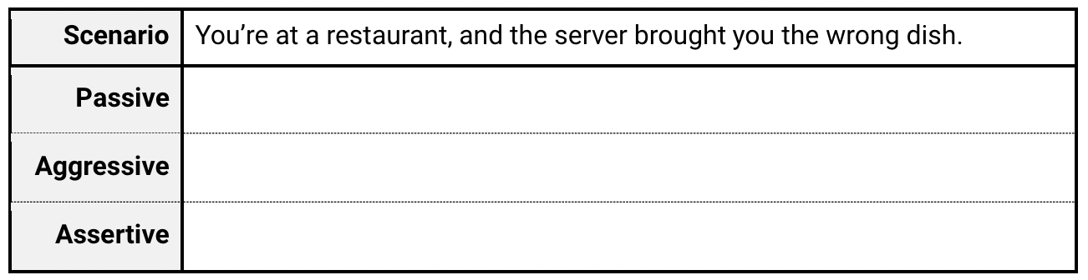
examples

Slide 12
let’s practice
A coworker takes credit for your idea during a meeting.
Your roommate consistently leaves dirty dishes in the sink.
Your colleague is frequently late for meetings, causing delays.
Your partner forgets to pick up groceries despite promising to do so.
Your group project partner consistently misses deadlines, affecting the team's progress.

Slide 13
healthy communication
Assertive communication
Calm tone
Actively listens and reflects

Slide 14
active listening
“I hear you saying that...”
“You’re telling me that...”
“It sounds like you feel...”

Slide 15
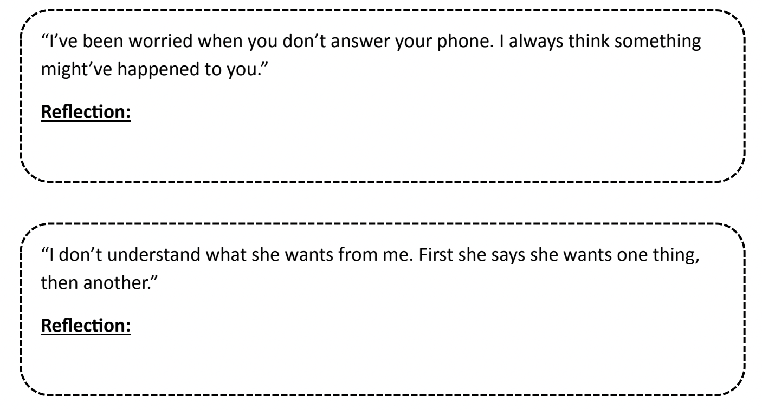
reflection

Slide 16
let’s practice
"I'm concerned about the changes our department is undergoing."
"I'm struggling to meet the project deadlines because I have too many tasks on my plate."
"I've been feeling overwhelmed lately because I'm handling multiple projects simultaneously, and it's affecting my productivity."
"I'm feeling really stressed about the upcoming client presentation. I'm worried I won't meet their expectations."

Slide 17
soft startups
Save the conversation for a calmer moment if possible (the brain in fight or flight)
Check your body language and tone of voice
Be clear, simple and specific when describing the issue
Be respectful
Look for resolution

Slide 18
core beliefs
Sometimes in our communication we are coming from a negative core belief instead of hearing what is actually going on in the conversation. This is impacting our ability to communicate effectively.
reflect + examine the evidence for this core belief

Slide 19
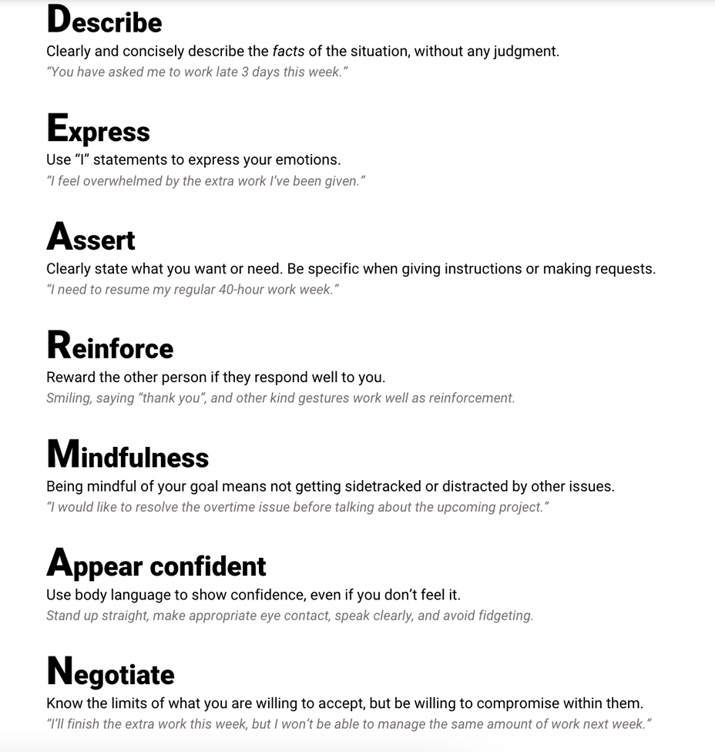
dearman

Slide 20
communication common mistakes
the four horsemen
criticism vs gentle startup
defensiveness vs taking responsibility
contempt vs fondness/admiration
stone walling vs self-soothing

Slide 21
In a difficult situation
Cope (ahead if you know beforehand or in the moment)
Confidence
Actively Listen
Empathetic Reflection
De-escalate
Solution Focused
Assertive Communication Style

Slide 22
Example: from both sides
You’ve missed a deadline and your manager schedules a discussion with you for tomorrow morning. You’ve had a lot of extra work lately since your teammates have been out sick.
Manager: “I wanted to talk this morning about the deadline you’ve missed. This is very unlike you, can you tell me what’s going on?”
Cope (ahead if you know beforehand or in the moment)
Confidence
Actively Listen
Empathetic Reflection
De-escalate
Solution Focused
Assertive Communication Style

Slide 23
Example: from both sides
A member of your team approaches you, feeling angry about the resources they have available for a specific project.
“We need more resources for this project; otherwise, we won't meet the deadlines! We can't keep diverting resources from other projects to accommodate this one!”

Slide 24
What to do when things take a negative turn
What’s my goal here?
Regulate with deep breaths
Actively listen to understand (not to respond) and do not interrupt
Remain composed
Avoid personal attacks
Do not escalate - attempt de-escalation
If needed hit pause and set time to return to the topic

Slide 25
In order to communicate through something difficult you must first cope with that stressor otherwise your brain is not functioning properly and efficiently and healthy communication skills go out the window

Slide 26
The brain’s ability to communicate under stress
understanding the stress response

Slide 27
Reducing Stress Beforehand if Possible
Go for a walk
Box breathing
Mindfulness
Review your own personal values

Slide 28
Reducing Stress in the Moment
Deep cleansing breaths
Stay present
Bilateral stimulation

Slide 29
Buidling Empathy
Listen and try to understand/know
Advocate for your people
Lookout for their wellbeing
Be transparent and consistent
Encourage feedback (what can I be doing better?)
builds a foundation

Slide 30

These tools are best used when guided by a therapist.
Therapists in your area can be found on www.psychologytoday.com
I am happy to provide referrals if you are looking for something specific in a therapist. Please don’t hesitate to reach out to me.

Slide 31

Q+A
stefanie@arisecounselingandtherapy.com
910-408-2302
www.arisecounselingandtherapy.com
@arisewilmington
credits
https://www.mindmypeelings.com/blog/cognitive-distortions
https://www.therapistaid.com/therapy-worksheets/cbt/none

