Slide 1

Caring for Yourself While Managing Others
STEFANIE ROBACK LCSW, LCAS
ARISE COUNSELING AND THERAPY

Slide 2

Stefanie Roback LCSW, LCAS
Master of Science in Social Work from Columbia University NYC 2016
Licensed Clinical Social Worker
Licensed Clinical Addiction Specialist
FOUNDER & CLINICIAN
Arise Counseling and Therapy Wrightsville Beach, NC

Slide 3


Disclaimer
This presentation is for the purpose of broad overview of a skill to address unhelpful thought patterns. This is not a replacement for therapy, medication or mental health treatment of any kind. If you need help finding resources, please reach out to me following this presentation.

Slide 4
why talk about this
Because you matter
+
We cannot manage others well if we cannot manage ourselves well
grounded
reliable
focused
present
energetic and uplifting
fight or flight
unfocused
not present
lack of energy

Slide 5
Taking Care of Yourself: Knowing Yourself Better

Slide 6
Building Self-Awareness
Know your values and attempt to make every decision in alignment with them
Take the time to learn yourself (strengths, weaknesses, habits, motivations)
Enjoying your life and finding a balance
Know your emotional triggers (address and do not repress)
Consider the effects of your actions on others
Ask for and be open to feedback (how can I be a better manager?)

Slide 7
Building Self-Awareness
Where will you see the impact of building self-awareness?
Improve relationships
Set the tone
Make better decisions
Attract and retain top tier team members
Increase productivity

Slide 8
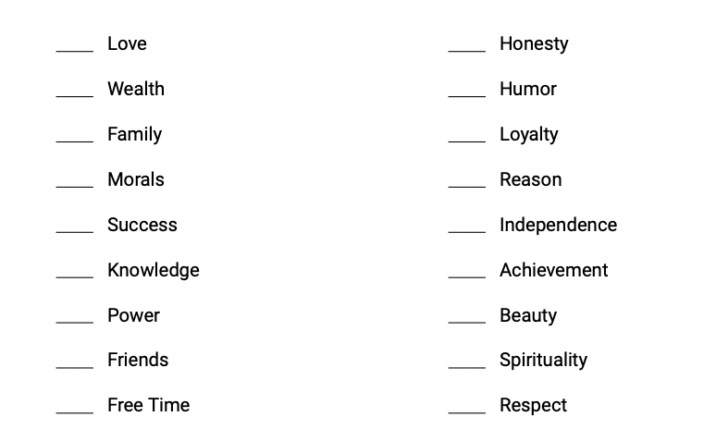
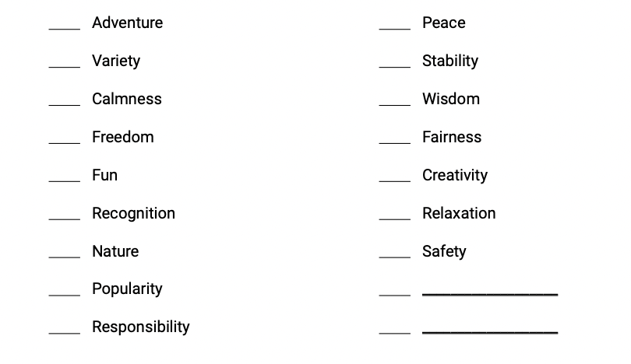
VALUES

Slide 9
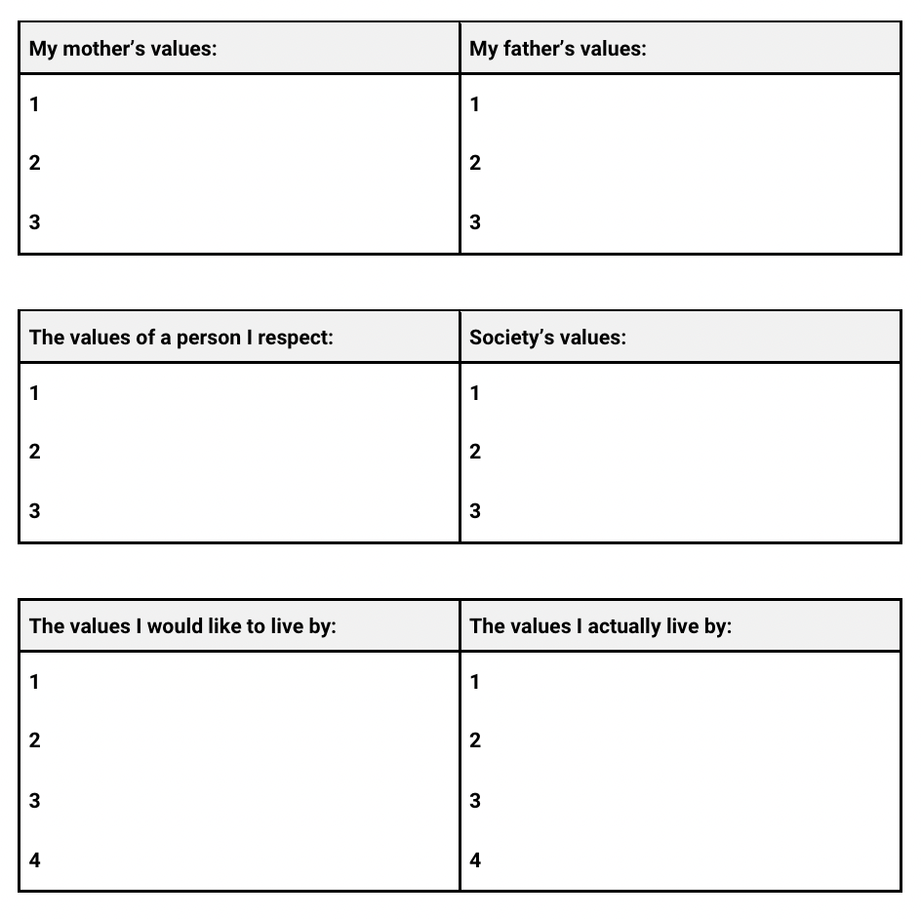
VALUES

Slide 10
Character Strength Inventory

Slide 11
Creating a Flourishing Life
finding your strengths and using them to belong to or in service of something greater than you are
Dr. Martin Seligman University of Pennsylvania
A Flourishing Life:
Positive Emotion
Engagement
Relationships
Meaning
Accomplishment

Slide 12
Leaning into your highest strength
The Workplace PERMA profile
Brief Strengths Test
www.authentichappiness.com

Slide 13
Taking Care of Yourself: The Taking Care Part
Self-Care Assessment

Slide 14
Self-Care Strategies
reflecting inward
Do you know your own limits?
Have you proactively adapted your work style to support work/life balance?
Are you feeling isolated?
What habits do you engage in that support your own well-being?
Do you let your team in on your struggles?

Slide 15
Self-Care Strategies
While at work:
Go for walks for fresh air (actually take in your surroundings)
Stop by a colleagues desk to chat
Stretch
Meditate at your desk or practice breathing exercises
Listen to music that you enjoy
Take a micro break and do a crossword puzzle or read a chapter of a book

Slide 16
Taking Care of Yourself:
Balance + Boundaries

Slide 17
Find Balance
If you’re feeling a lack of energy: shift focus to improving your sleep routine and physical activity
Learn about something other than work (read, visit a museum, watch a documentary)
Cook dinner for yourself a few times per week
Go on a fun outing with others once per week (at least)
Join a group of like-minded people (run club, book club etc)
Try a new hobby once per month
Do something to feel taken care of

Slide 18
Healthy Boundaries
Have healthy work boundaries (time you log off at night, taking the weekend to be with friends/family, taking vacations)
Be clear and communicate directly
Be a role model - let your team members hear from you about how living a more balanced life has impacted you
Being vulnerable increases team morale but lack of boundaries causes confusion and chaos

Slide 19
Taking Care of Yourself:
Triggers and Coping

Slide 20
Recognizing if you’ve become triggered at work
Feeling angry and irritable
Feeling overwhelmed
Sensory sensitivity
Dissociation (disconnected, foggy, confused)
Ruminating
Startle easily
intrusive thoughts
Heart racing

Slide 21
Coping
Feel it
Social and/or Professional Support
Gain a Healthier Perspective
Categorize and Prioritize - Rubber vs. Glass
Basic Self Care Check-in
Live a Balanced Life / Personal Time
In the Moment

Slide 22

Coping
box breathing
hold for 4
in for 4
out for 4
hold for 4

Slide 23
Coping
senses + choices
See
Touch
Hear
Smell
Taste
Which is your favorite in each category?

Slide 24
Taking Care of Yourself:
Addressing Your Thoughts

Slide 25

Reframing
Our brains are neuroplastic.
Repetition = the most important part of reframing unhelpful thoughts.

Slide 26
from irrational to a more helpful thought
Many of us experience irrational thoughts that we can’t help but get
caught up in. Feeling anxious, worried, sad or out of control can
be caused by irrational thoughts.
Your thoughts have the power to control your emotions.
Reframing is a tangible tool to use.

Slide 27
Cognitive Behavioral Therapy
1960'S
TOOLS
DR. AARON BECK
One tool amongst many tools involved in cognitive
behavioral therapy is reframing irrational thoughts.
Originated in the 1960’s through the work of
psychiatrist Aaron Beck

Slide 28
What is an automatic thought?
These thoughts arrive quickly and oftentimes out of our awareness. We might fail to notice them, but they greatly affect how we feel, our mood and how we perceive what’s going on in the world around us.
These thoughts are often negative and irrational and in need of a reframe.

Slide 29
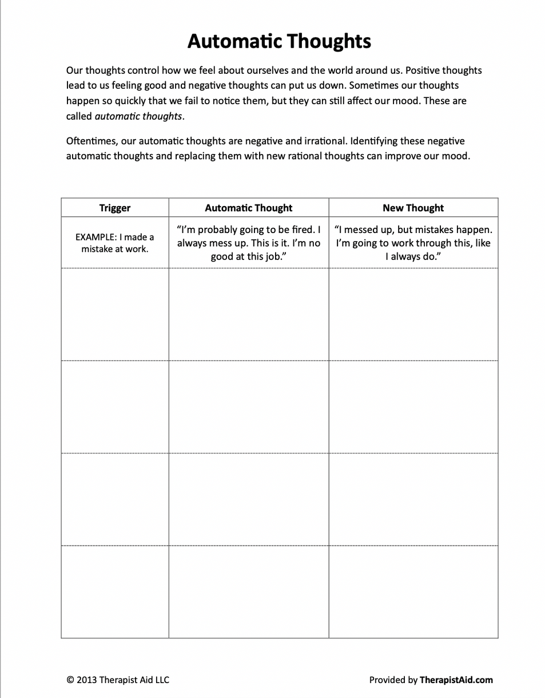

Slide 30

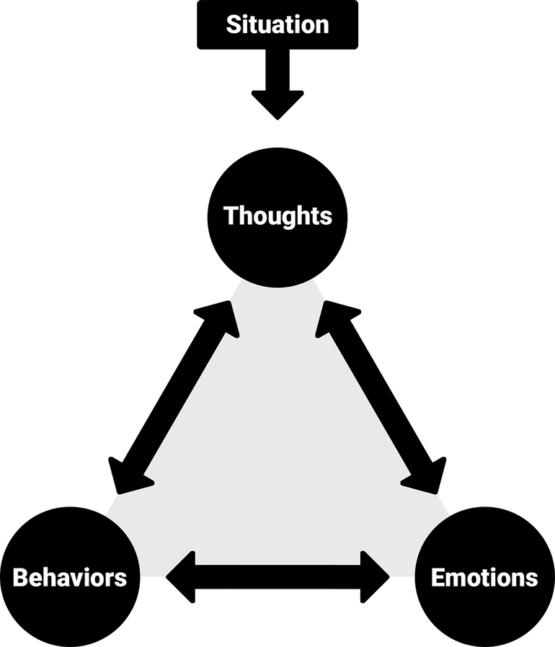
The Cognitive Triangle
The cognitive triangle shows how thoughts, emotions, and behaviors affect one another. This means changing your thoughts will change how you feel and behave.
A situation is anything that happens in your life, which triggers the cognitive triangle.
Thoughts are your interpretations of a situation. For example, if a stranger looks at you with an angry expression, you could think: “Oh no, what did I do wrong?” or “Maybe they are having a bad day.”
Emotions are feelings, such as happy, sad, angry, or worried. Emotions can have physical components as well as mental, such as low energy when feeling sad, or a stomachache when nervous.
Behaviors are your response to a situation.
Behaviors include actions such as saying something or doing something (or, choosing not to do something).
© 2021 Therapist Aid LLC
Provided by TherapistAid.com

Slide 31
The Cognitive Triangle
The cognitive triangle shows how thoughts, emotions, and behaviors affect one another. This means changing your thoughts will change how you feel and behave.
restaurant experience
A situation is anything that happens in your life, which triggers the cognitive triangle.
Thoughts are your interpretations of a situation. For example, if a stranger looks at you with an angry expression, you could think: “Oh no, what did I do wrong?” or “Maybe they are having a bad day.”
Emotions are feelings, such as happy, sad, angry, or worried. Emotions can have physical components as well as mental, such as low energy when feeling sad, or a stomachache when nervous.
Behaviors are your response to a situation.
Behaviors include actions such as saying something or doing something (or, choosing not to do something).
© 2021 Therapist Aid LLC
Provided by TherapistAid.com

Slide 32
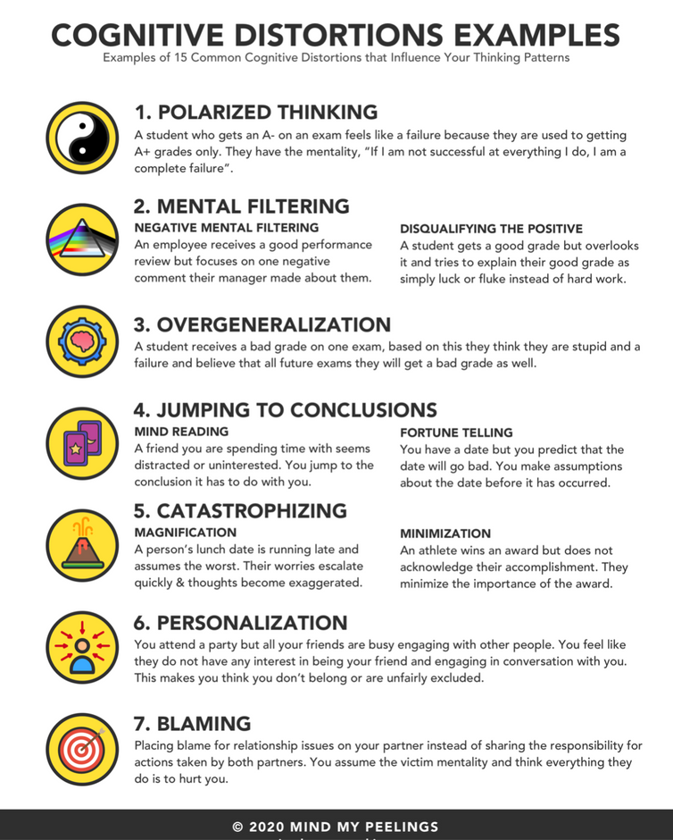
Cognitive Distortions AKA Irrational Thoughts

Slide 33
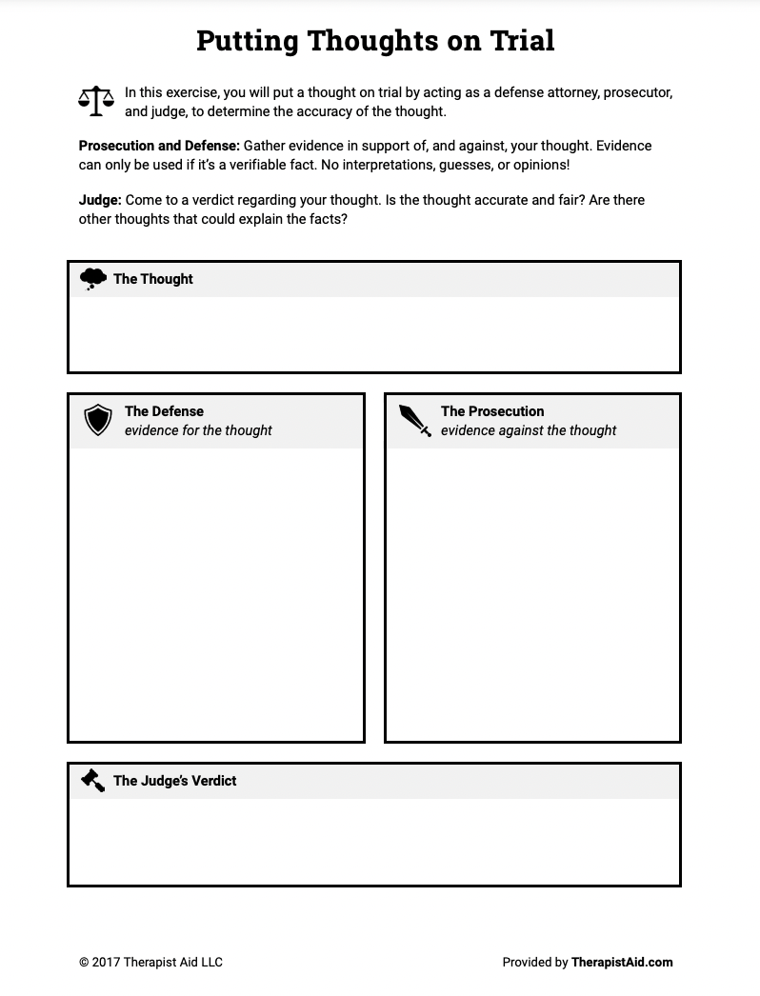

Slide 34
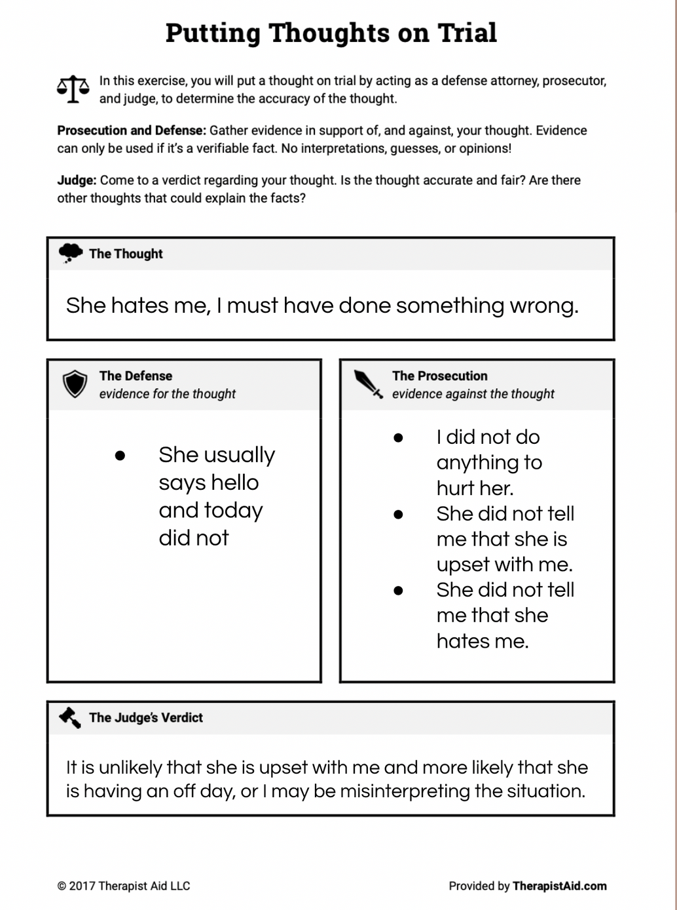
Emotions:
Empathetic
Compassionate
Neutral
Behavior:
Providing a listening ear
Going about work tasks as usual
Emotions:
Stressed
Sad
Angry
Frustrated
Worried
Behavior:
Closed Off
Overcompensating
Rude
Quiet

Slide 35
Re-energize
You are more than just a career journey
Embrace the power of a break
Understand and manage on-going stress
Know when you need outside support

Slide 36

These tools are best used when guided by a therapist.
Therapists in your area can be found on www.psychologytoday.com
I am happy to provide referrals if you are looking for something specific in a therapist. Please don’t hesitate to reach out to me.

Slide 37

Q+A
stefanie@arisecounselingandtherapy.com
910-408-2302
www.arisecounselingandtherapy.com
@arisewilmington
credits
https://www.mindmypeelings.com/blog/cognitive-distortions
https://www.therapistaid.com/therapy-worksheets/cbt/none

