Slide 1

Spotting Concerning Behaviors and Learning to Support Your Team
STEFANIE ROBACK LCSW, LCAS
ARISE COUNSELING AND THERAPY

Slide 2

Stefanie Roback LCSW, LCAS
Master of Science in Social Work from Columbia University NYC 2016
Licensed Clinical Social Worker
Licensed Clinical Addiction Specialist
FOUNDER & CLINICIAN
Arise Counseling and Therapy Wrightsville Beach, NC

Slide 3

Disclaimer
This presentation is for the purpose of broad overview of a skill to address unhelpful thought patterns. This is not a replacement for therapy, medication or mental health treatment of any kind. If you need help finding resources, please reach out to me following this presentation.

Slide 4
why talk about this
for the wellbeing of yourself, your team and that employee

Slide 5
building self-awareness
know your biases and do work there
educate yourself (aware, not expert)

Slide 6
what you might be seeing
most commonly: anxiety, burnout, chronic stress and depression
others: substance abuse, suicidal ideation, eating disorders, psychotic disorders etc.

Slide 7
warning signs
that there may be a bigger issue going on
unkempt or abnormal appearance
significant mood swings
taking a lot of time off
easily frustrated
changes in eating/sleeping
taking a lot of time off
excessive worry
reduction in productivity (significant)
social withdrawal

Slide 8
mental health
Risks to mental health at work can include:
under-use of skills or being under-skilled for work;
excessive workloads or work pace, understaffing;
long, unsocial or inflexible hours;
lack of control over job design or workload;
unsafe or poor physical working conditions;
organizational culture that enables negative behaviours;
limited support from colleagues or authoritarian supervision;
violence, harassment or bullying;
discrimination and exclusion;
unclear job role;
under- or over-promotion;
job insecurity, inadequate pay, or poor investment in career development; and
conflicting home/work demands.
World Health Organization

Slide 9
substance use
Signs you might notice:
Decreased quality of work or productivity
Constant health issues
Increase in absences
Changes in behavior
Financial concerns
Slurring words + absurd behavior

Slide 10
Safety is the priority
If you believe someone may be a risk to themselves or someone else:
Call 911 if you have notice of immediate danger
If you suspect something is going on but don’t know for sure, contact human resources to find out next steps
Offer kindness and support as appropriate

Slide 11
Follow protocol/legal requirements
Consult human resources and upper managment

Slide 12
Addressing prolonged or heightened stress in your team members
What can potentially cause prolonged stress in the workplace?
Unrealistic expectations
Limited opportunities for growth and low compensation
Excessive workload
Culture issues
Lack of support
How might someone experiencing prolonged stress present?
Tired
Skipping breaks
Dip in productivity
Irritable
Withdrawn

Slide 13
addressing prolonged stress in your team members
one on one:
Opening channels of communication
Building community
Creating a culture of trust
Boosting self-awareness
organizationally
bringing awareness to the importance of self-care and mental wellness
offering opportunities at work for self-care and learning (workshops, guided meditations, journaling groups etc)
normalizing taking time off and having a work/life balance
have a culture that fosters the wellness of others

Slide 14
addressing burnout
How can it present?
Lack of interest or enthusiasm
Cynical regarding work
Disengaged
Negative attitude
Lower quality work

Slide 15
addressing burnout
Reach out and let them know what you’re noticing (be open-minded and curious about the response)
Employee satisfaction surveys
Assess your own management style
Encourage breaks and relaxation
Provide professional resources

Slide 16
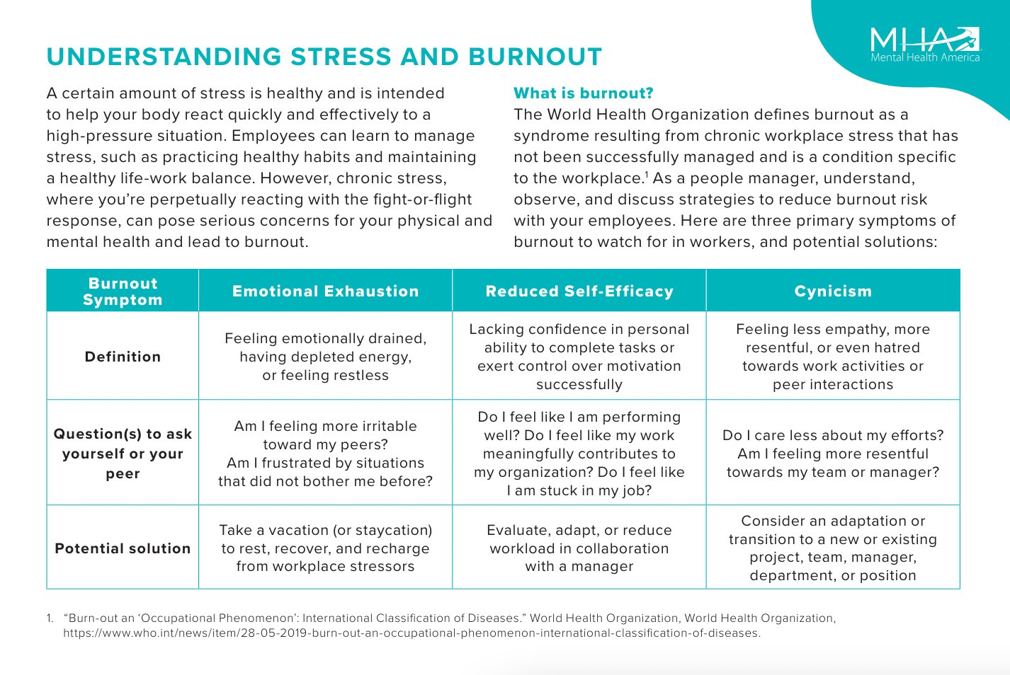

Slide 17
addressing mental illness
Educate yourself on mental health and mental illness
Ask open ended questions: “How are you feeling today?” “How can I help?”
Actively listen
Resist offering solutions
Validate and reflect
If appropriate and comfortable, relate to them
Refer them to resources (human resources, myself, upper management)
Respect their privacy
Check your own biases
Know your bounds (you are not a MH professional and that’s okay)

Slide 18
examples + practice
Do you:
leave it be
bring it up
get outside help
Remote Example: Sarah has been an exemplary employee for several years, but recently her performance has declined. She frequently misses deadlines, forgets important details in her tasks, and seems disengaged during meetings. Lately, she's been arriving late to work and taking more sick days than usual.

Slide 19
culture: a protective factor
Positive, uplifting environment
Open conversations about health and wellness
Respectful of privacy/don’t promote gossip
Genuine interest and care in employees
Accessibilty and normalizing resources
How does Live Oak do this?
Do you see any ways you can do more of this for your team?

Slide 20
Starting the conversation
“I noticed ....”
“How are you feeling?”
“How can I help”
“You don’t need to share with me, but please know I’m here to support you should you decide to”

Slide 21
Providing support
Know your limits and boundaries
Don’t give advice that you’re not trained to give
Lean toward providing validation and resources

Slide 22
Providing resources
Human resources
Therapists in town
Psychology Today

Slide 23
Examples
  Go back to your previous example -
How might you start this conversation?
2. Real examples

Slide 24
Building empathy
Imagine a diffiuclt time in your life and now imagine bringing that to someone at work. How would you want them to respond? What might that person be feeling? How much courage does it take to look for help?

Slide 25
Holding boundaries
Stick to what you know
Focus on what is in your control
Do what you feel comfortable doing
Stick to what your responsibility is

Slide 26
Seeking support for yourself
Upper management
Human Resources
Myself
Your own mental health provider

Slide 27
Notice what you’re feeling
Triggered
Helpless
Worried
Overwhelmed
Judgemental

Slide 28
Notice what you’re thinking (automatic thoughts)
“I wasn’t able to help my brother with drug addiction, I won’t be able to help this person”
“I am not equipped to help this person”
“They are just looking for attention”
“What if something terrible happens to them?”

Slide 29
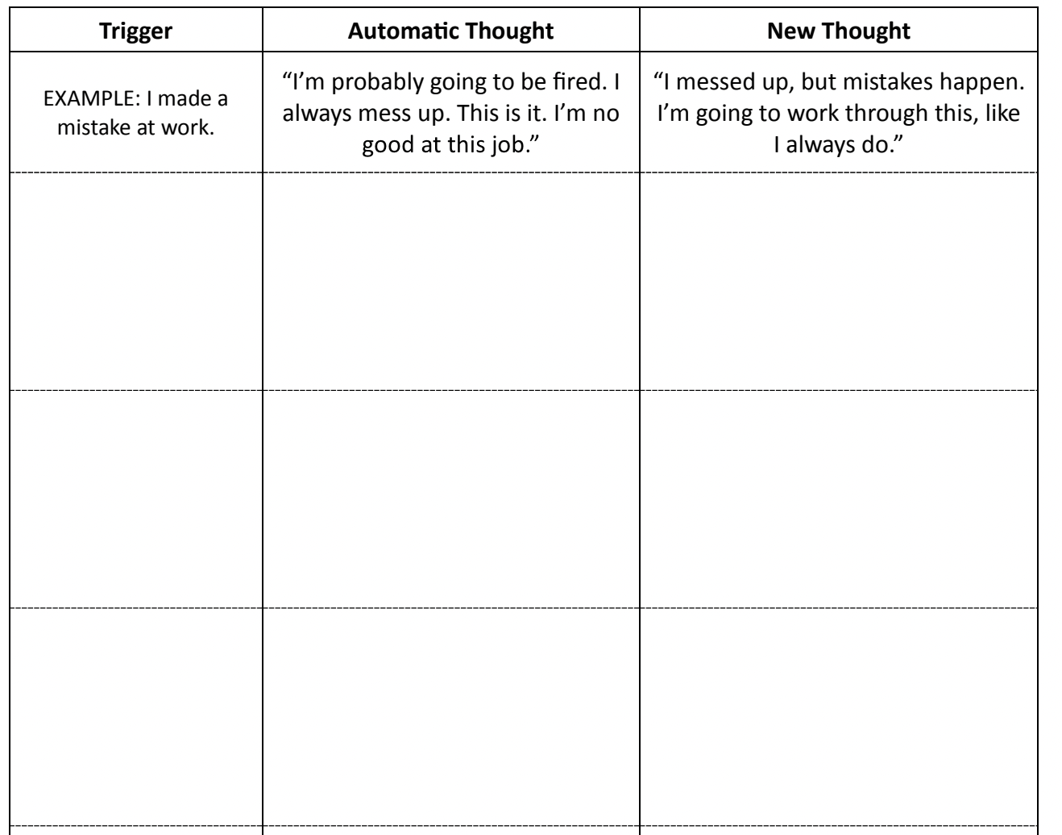
Reframe automatic thoughts based on facts

Slide 30
Reframe automatic thoughts based on facts
“I wasn’t able to help my brother with drug addiction, I won’t be able to help this person” -->
“It’s a good thing they brought this to my attention, let me focus on what I can control here.”
“I am not equipped to help this person” --> “I’m not a mental health professional but I do know the direction to point this person”
“They are just looking for attention” --> “I can actively listen and show this person I support them and care about their issue even if I don’t understand it.“
“What if something terrible happens to them?” --> “I cannot control every decision someone makes but I can control offering them support and resources to the best of my ability”

Slide 31
Review + Follow Up Questions
Taking Care of Yourself While Managing Others
Effective Communication Skills for Difficult Situations
Spotting Concerning Behaviors and Learning to Support Your Team

Slide 32

These tools are best used when guided by a therapist.
Therapists in your area can be found on www.psychologytoday.com
I am happy to provide referrals if you are looking for something specific in a therapist. Please don’t hesitate to reach out to me.

Slide 33

Q+A
stefanie@arisecounselingandtherapy.com
910-408-2302
www.arisecounselingandtherapy.com
@arisewilmington
credits
https://www.mindmypeelings.com/blog/cognitive-distortions
https://www.therapistaid.com/therapy-worksheets/cbt/none

